Slide 1




AtliQ Grands Hospitality Analysis
Arindam Das
Resume Project Challenge -1

Slide 2
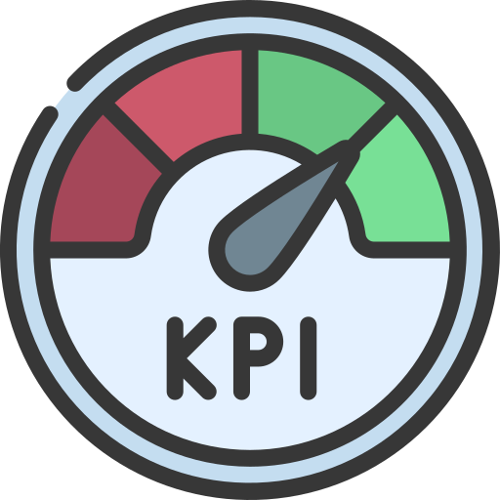

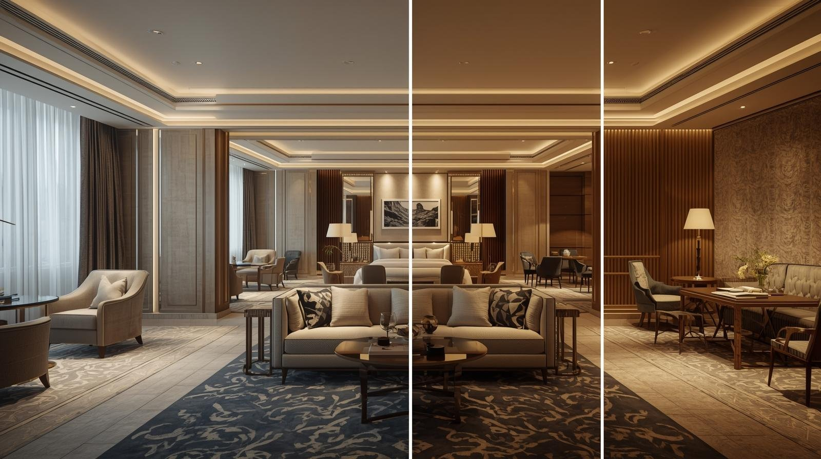
Agenda
Business Overview
Problem Statement
What’s Next? Strategic Goal
AtliQ Grands Hotel Chain System
Entity-Relationship Diagram (ERD)
Key Performance Indicators (KPIs)
Dashboard Visualization
Insights Achieved
Strategic Recommendations
Resources Utilized

Slide 3

Business Overview
AtliQ Grands is a luxury hotel chain with five-star properties across major Indian states including Maharashtra, Delhi, Karnataka, and Tamil Nadu. Renowned for its premium hospitality, world-class amenities, and exceptional guest experiences, the brand has been serving business and leisure travelers for over 20 years.
Hotel Properties: AtliQ Bay, AtliQ Blu, AtliQ City, AtliQ Exotica, AtliQ Grands, AtliQ Palace, AtliQ Seasons.
Room Categories/Class: Business, Standard, Luxury, Elite, Premium and Presidential.
City Locations: Hyderabad, Bangalore, Mumbai and Delhi.

Slide 4
Problem Statement
AtliQ Grands, a leading five-star hotel chain in India, is losing market share and revenue in the luxury/business segment due to strong competitor strategies and ineffective management decisions. To address this, the management seeks to adopt Business and Data Intelligence for informed decision-making, but currently lacks an in-house analytics team.
In response to this challenge, the management decided to onboard external data analytics expertise to uncover actionable insights from historical booking and revenue data. The goal is to build a centralized dashboard that empowers the revenue team to identify performance gaps, optimize pricing strategies, and improve channel efficiency across properties

Slide 5
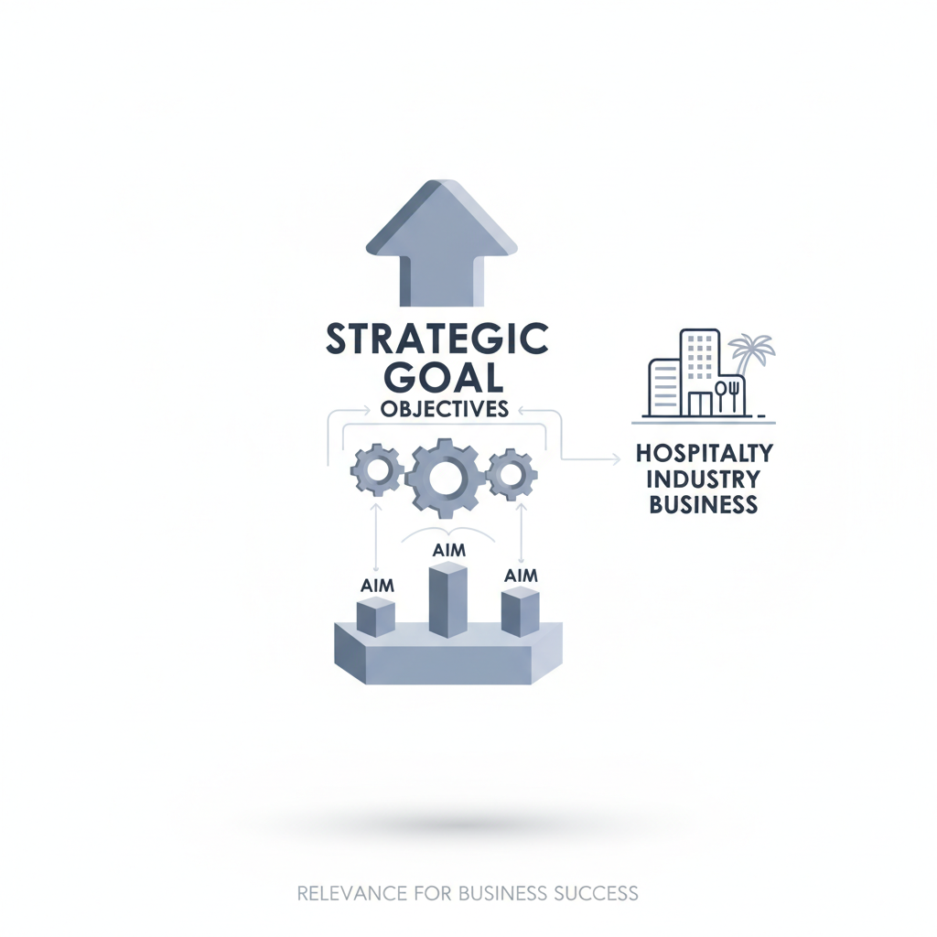
What’s Next? Strategic Goal
Strategic Goal: Improve market share and revenue through data-driven decision-making.
Objective: Incorporate Business Intelligence to drive strategic actions across pricing, occupancy, and channel performance.
Aim: Empower the revenue team to outplay competitors by identifying growth opportunities and optimizing performance through timely insights.

Slide 6
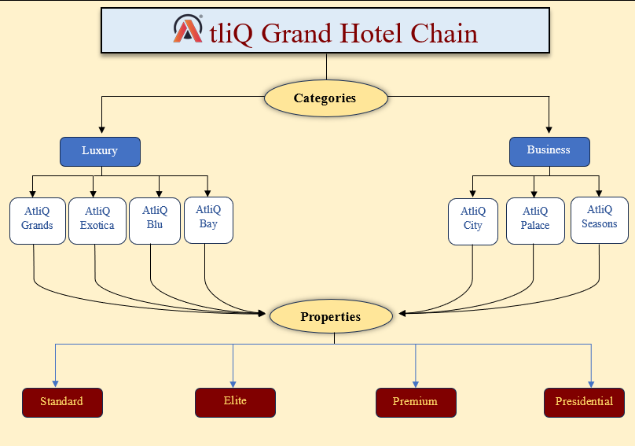
AtliQ Grands Hotel Chain System

Slide 7
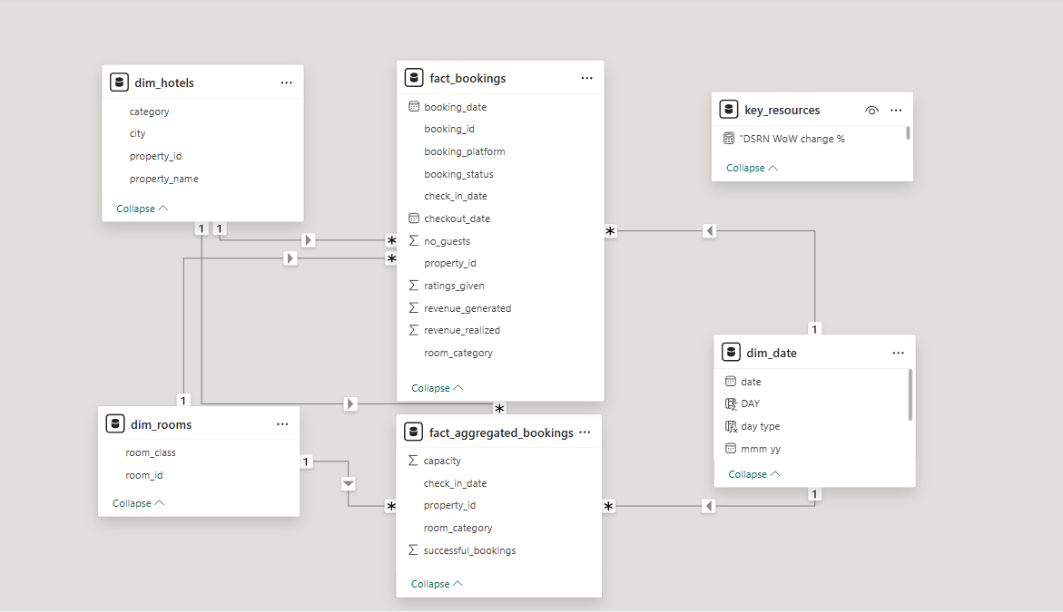
Entity-Relationship Diagram (ERD)
Jul
c
Feb
Mar
Apr
May

Slide 8
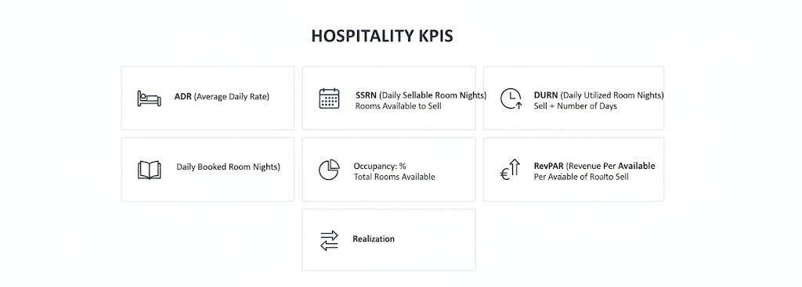
Key Performance Indicators (KPIs)
ADR (Average Daily Rate): Total Rooms Revenue/Number of Rooms Sold
DSRN (Daily Sellable Room Nights): Total Rooms Available to Sell/Number of Days
DURN (Daily Utilized Room Nights): Total Checkouts/Number of Days
DBRN (Daily Booked Room Nights): Total Bookings/Number of Rooms Sold
Occupancy: %: Total Rooms Occupied/Total Rooms Available
RevPAR (Revenue Per Available Room): Total Revenue/Total Rooms Available to Sell
Realization: DURN / DBRN

Slide 9

Dashboard Visualization

Slide 10

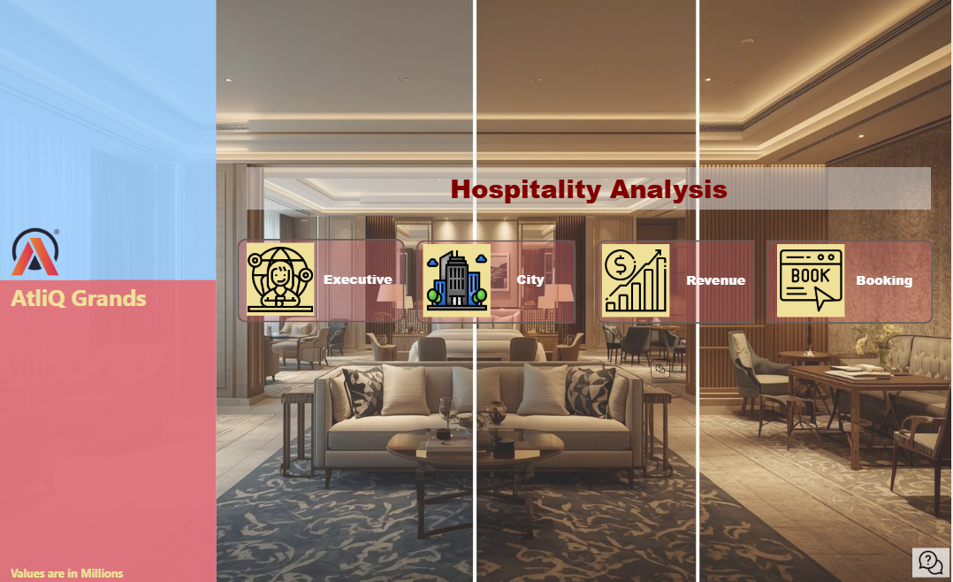
Home Page

Slide 11
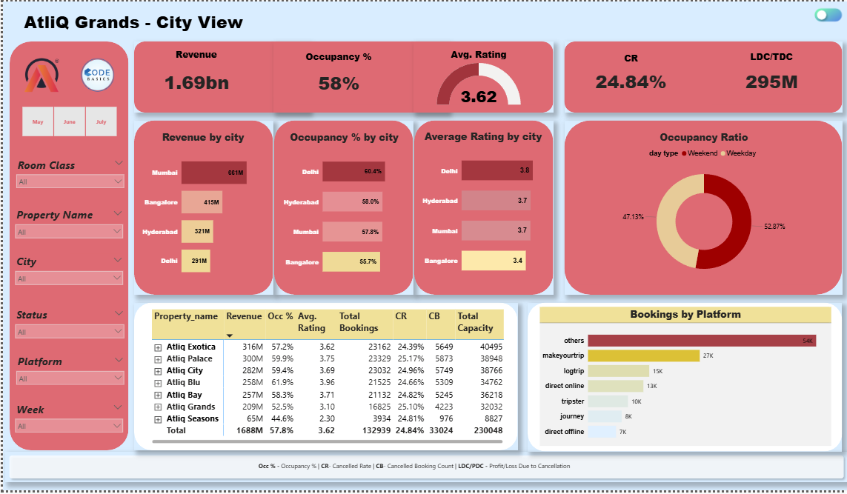
City View

Slide 12
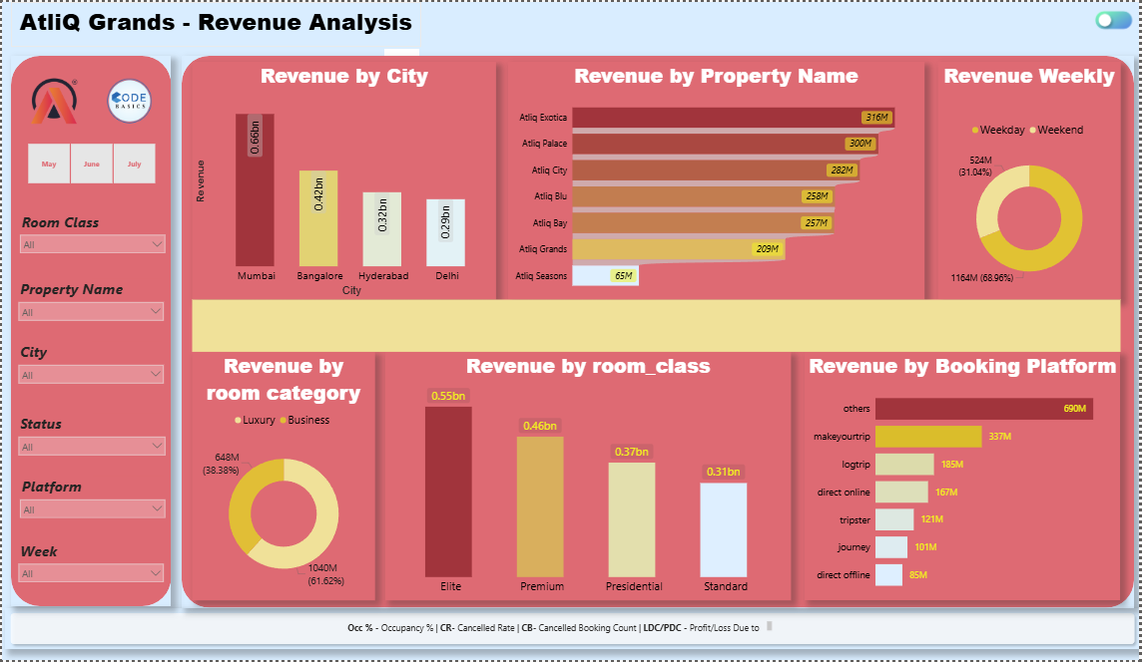
Revenue View

Slide 13
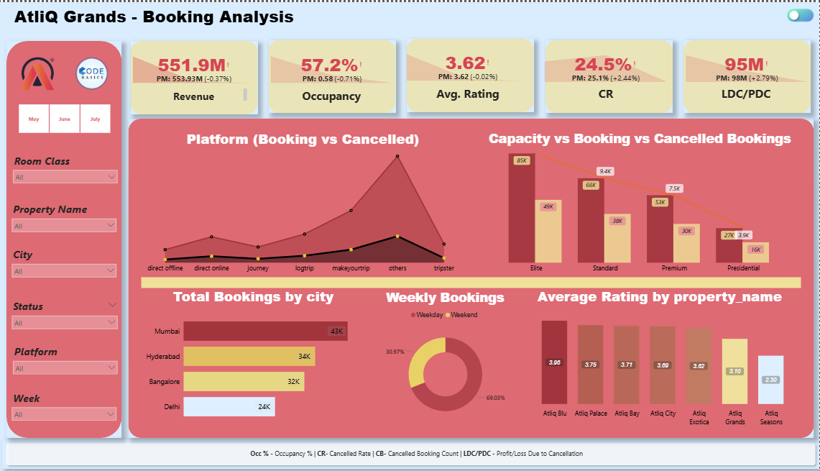
Booking View

Slide 14
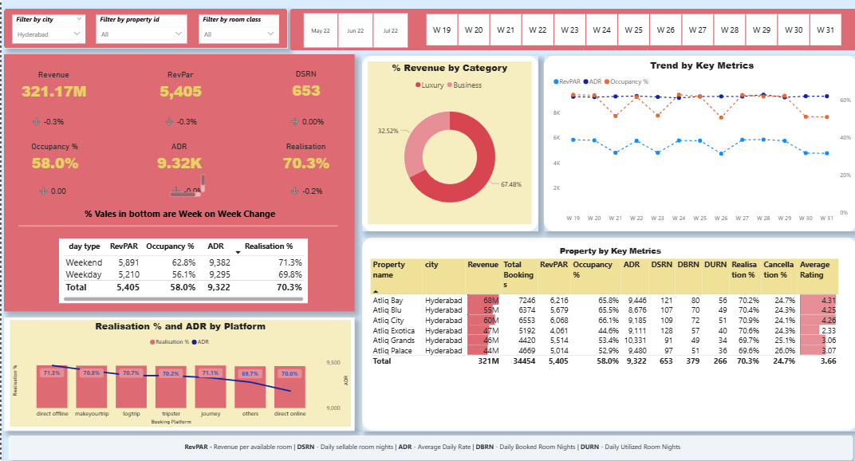
Executive View

Slide 15

Strategic Recommendation
Let’s dive in

Slide 16
Insights Achieved
📍 City-Wise Performance
Mumbai emerged as the top revenue generator with 660.6M, trailed by Bangalore (415M), Hyderabad (321.2M), and Delhi (290.9M).
Delhi stands out with the highest occupancy rate (60.4%) and the best average guest rating (3.8).
🏨 Properties & Room Categories
AtliQ Exotica ranked as the best-performing property, securing 316M revenue, with an average rating of 3.62, 57.2% occupancy, and a 24.39% cancellation ratio.
Luxury rooms were the biggest revenue driver, contributing 61.62%, whereas the Business category added 38.38%.
Elite rooms achieved the highest earnings (554M), while Standard rooms generated the least (306M).
📊 Booking Platforms
The majority of bookings came via other channels – 55K reservations worth 690M.
MakeYourTrip contributed to generating 337M revenue.
Direct offline bookings were the lowest, totaling 7K and 85M revenue.
📅 Time-Based Trends
May recorded the peak revenue (581.93M), ahead of June and July.
Weekdays contributed the bulk of income (71.72%), while weekends accounted for 28.28%.
Occupancy levels rose by 7% on weekends (Fri–Sat), although RevPAR showed little variation.
Overall Summary
Total Revenue: 1.69 Billion
Average Occupancy: 57.8%
Cancellation Ratio: 24.5%
Guest Rating (Average): 3.62
RevPAR Insights
Mumbai recorded the highest RevPAR at 8.9K.
Hyderabad posted the lowest RevPAR at 5.4K.

Slide 17
Strategic Recommendations
Boost Customer Ratings
Customer ratings can be improved by ensuring consistent service quality, maintaining high standards of cleanliness, and aligning the actual guest experience with online content. Better ratings lead to higher visibility, increased bookings, and stronger brand trust.
Implement Dynamic Pricing:
With ADR remaining nearly flat across weekdays, weekends, and peak seasons, dynamic pricing models should be introduced across properties and platforms. This will help capture demand-driven revenue and optimize profitability throughout the year.
Optimize Room Pricing Based on Occupancy:
With overall occupancy at 57.9%, properties with lower utilization should adopt flexible pricing strategies. Adjusting rates based on demand and seasonality can improve room fill rates and drive incremental revenue.
Address High Cancellation Rates:
Channels like Others and MakeMyTrip show elevated cancellation rates (~25%), which negatively impact search rankings and booking conversions. Elite rooms also show high cancellation ratios. These areas require focused attention through better policies, content accuracy, and guest engagement.

Slide 18

Resources Utilized
Image Courtesy:
Icon by Freepik
Photo by Google Gemini

Slide 19
THANK YOU.

